Slide 1
Mod 3:Arithmetic Algorithms
Topics :
Multiplication of unsigned no’s(Array multiplier, sequential multiplier)
Booth’s Multiplication Algorithm
Fast multiplication algorithms.
Restoring & Non Restoring Division

Slide 2
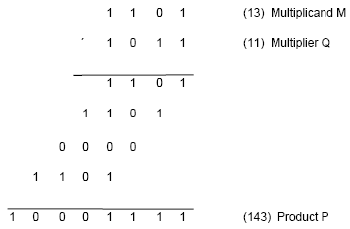
Multiplication of unsigned numbers
Product of 2 n-bit numbers is at most a 2n-bit number.
Unsigned multiplication can be viewed as addition of shifted
versions of the multiplicand.

Slide 3
Multiplication of unsigned numbers (contd..)
We added the partial products at end.
  Alternative would be to add the partial products at each stage.
Rules to implement multiplication are:
  If the i^{th} bit of the multiplier is 1, shift the multiplicand and add the shifted multiplicand to the current value of the partial product.
  Hand over the partial product to the next stage
  Value of the partial product at the start stage is 0.

Slide 4
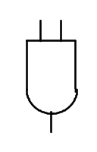
Multiplication of unsigned no’s:Array multiplier
Typical multiplication cell
Bit of incoming partial product (PPi)
j^{th} multiplicand bit
i^{th} multiplier bit
i^{th} multiplier bit
carry out
FA
carry in
Bit of outgoing partial product (PP(i+1))

Slide 5
array multiplier
array multiplier
Multiplicand
(PP0)
0
m
3
0
m
2
0
m
1
0
m
0
q
0
PP1
0
q
p
0
0
1
PP2
p
Multiplier
q
2
1
0
PP3
p
2
q
3
0
p
p
p
p
p
,
7
6
5
4
3
Product is: p₇,p₆,..p₀
Multiplicand is shifted by displacing it through an array of adders.

Slide 6
Array multiplier (contd..)
The main component in each cell is the adder circuit.
The AND gate in any cell determines whether a multiplicand bit mj, is added to the incoming partial product bit, based on the value of the multiplier bit qi.
Each row I adds the multiplicand to the incoming partial product if qi=1.
If qi=0,PPi is passed vertically downward unchanged.
PP0 is all 0’s and PP4 is the desired product. The multiplicand is shifted left one position per row by diagonal signal path.
array multipliers are:
  Extremely inefficient.
  Have a high gate count for multiplying numbers of practical size such as 32-bit or 64-bit numbers.
  Perform only one function, namely, unsigned integer product.
Improve gate efficiency by using a mixture of combinatorial array techniques and sequential techniques requiring less combinational logic.

Slide 7
Sequential multiplication
Recall the rule for generating partial products:
  If the ith bit of the multiplier is 1, add the appropriately shifted multiplicand to the current partial product.
  Multiplicand has been shifted left when added to the partial product.
However, adding a left-shifted multiplicand to an unshifted partial product is equivalent to adding an unshifted multiplicand to a right-shifted partial product.

Slide 8
Sequential Circuit Multiplier
Register A (initially 0)
Shift right
C
a
n
-
1
a
q
q
0
n
-
1
0
Multiplier Q
Add/Noadd
control
n-bit
Adder
MUX
Control
sequencer
0
0
m
n
-
1
m
0
Multiplicand M

Slide 9
Sequential multiplication (contd..)
M
1 1 0 1
Initial configuration
0
0 0 0 0
1 0 1 1
C
A
Q
0
1 1 0 1
1 0 1 1
Add
First cycle
0
0 1 1 0
1 1 0 1
Shift
1
0 0 1 1
1 1 0 1
Add
Second cycle
0
1 0 0 1
1 1 1 0
Shift
0
1 0 0 1
1 1 1 0
No add
Third cycle
0
0 1 0 0
1 1 1 1
Shift
1
0 0 0 1
1 1 1 1
Add
0
1 0 0 0
1 1 1 1
Shift
Fourth cycle
Product

Slide 10
Multiplication of signed-operands
Recall we discussed multiplication of unsigned numbers:
  Combinatorial array multiplier.
  Sequential multiplier.
Need an approach that works uniformly with unsigned and signed (positive and negative 2’s complement) n-bit operands.
Booth’s algorithm treats positive and negative 2’s complement operands uniformly.
Booth’s algorithm applies uniformly to both unsigned and 2’s complement signed integers.
  Basis of other fast product algorithms.
  This algorithm has the benefit of speeding up the multiplication process relative to a more straightforward approach.
  Booth’s algorithm preserves the sign of the result.
<number>\

Slide 11
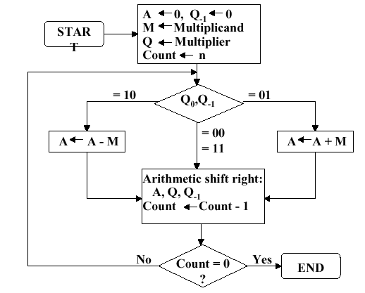
Booth’s algorithm
Booth’s algorithm is depicted below

Slide 12
Booth’s algorithm(contd..)
Multiplier and multiplicand are placed in Q and M registers.
Q(-1) is a 1 bit register placed logically to the right of LSB.
Results of Multiplication will appear in A and Q register.
Initially A and Q(-1) are initialized to zero.
Control logic scans the bits of the multiplier, and the bit to the right of the multiplier.
If the two bits are the same (1-1,0-0),then all bits of A, Q, Q(-1) registers are shifted to right 1 bit.
If the two bits differ(0-1,1-0),then the multiplicand is added to or subtracted from A register. Then right shift occurs.
Right shift is such that the leftmost bit of A, namely A(n-1),
Not only shifted into A(n-2) but also remains in A(n-1).This is required to preserve the sign of no in A & Q. This shift is called arithmetic shift, because it preserves sign bit

Slide 13
Booth’s algorithm (contd..)
Inputs: n-bit multiplier Q
n-bit multiplicand x
Output will have 2n bits
Algorithm: For every bit in Q:
1. Examine the bit and its neighbor to the immediate right.
If the bit pair is:
00 – do nothing.
01 – Add the multiplicand to the upper half of PP.
10 – Sub the multiplicand from the upper half of PP.
11 – Do nothing.
2. Shift the PP right by one bit, extending the sign bit.

Slide 14
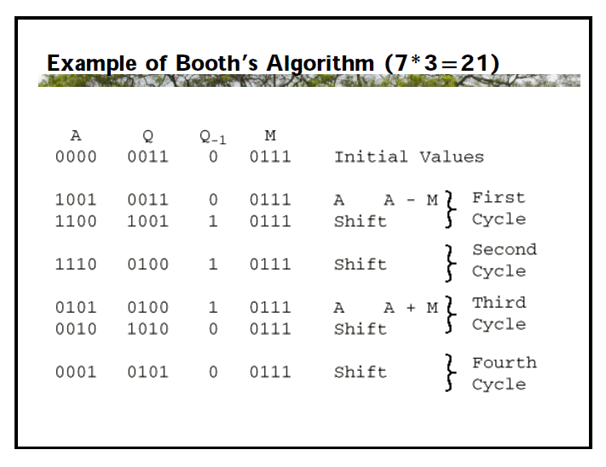
Example of Booth’s Algorithm

Slide 15
Fast Multiplication

Slide 16
Bit-Pair Recoding of Multipliers
Bit-pair recoding halves the maximum number of summands (versions of the multiplicand).
This technique can be derived directly from booth’s algorithm.
Sign extension
Implied 0 to right of LSB
1
1
1
0
1
0
0
0
0
−
1
+
1
−
1
0
0
−
1
−
2
(a) Example of bit-pair recoding derived from Booth recoding

Slide 17
Bit-Pair Recoding of Multipliers
Multiplier bit-pair
Multiplier bit on the right
Multiplicand
i
+
1
i
i
−
1
selected at position
i
0
0
0
0
X M
0
0
1
+
1
X M
0
1
0
+
1
X M
0
1
1
+
2
X M
1
0
0
−
2
X M
1
0
1
−
1
X M
1
1
0
−
1
X M
1
1
1
0
X M
(b) Table of multiplicand selection decisions

Slide 18
Bit-Pair Recoding of Multipliers
0
1
1
0
1
0
-
1
+
1
-
1
0
0
0
0
0
0
0
0
0
0
0
1
1
1
1
1
0
0
1
1
0
0
0
0
1
1
0
1
1
1
1
0
0
1
1
0
1
1
0
1
(
+
13
)
0
0
0
0
0
0
×
1
1
0
1
0
(
-
6
)
1
1
1
0
1
1
0
0
1
0
(
-
78
)
0
1
1
0
1
0
-
1
-
2
1
1
1
1
1
0
0
1
1
0
1
1
1
1
0
0
1
1
0
0
0
0
0
0
1
1
1
0
1
1
0
0
1
0
Figure 6.15. Multiplication requiring only n/2 summands.

Slide 19
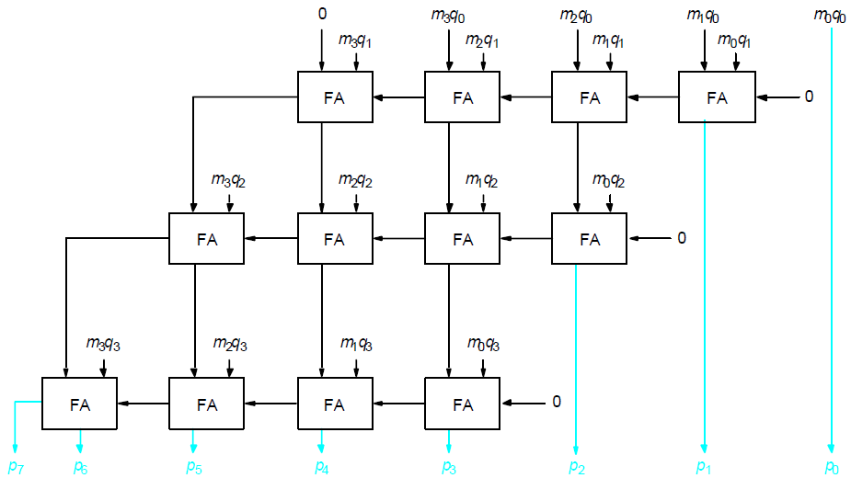
Carry-Save Addition of Summands
CSA speeds up the addition process.
P7
P6
P5
P4
P3
P2
P1
P0

Slide 20
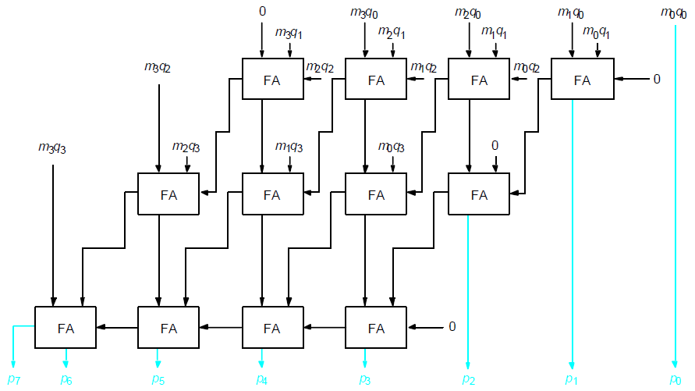
Carry-Save Addition of Summands(Cont.,)
P7
P6
P5
P4
P3
P2
P1
P0

Slide 21
Carry-Save Addition of Summands(Cont.,)
Consider the addition of many summands, we can:
Group the summands in threes and perform carry-save addition on each of these groups in parallel to generate a set of S and C vectors in one full-adder delay
Group all of the S and C vectors into threes, and perform carry-save addition on them, generating a further set of S and C vectors in one more full-adder delay
Continue with this process until there are only two vectors remaining
They can be added in a RCA or CLA to produce the desired product.
Delay through the carry save array is somewhat less than delay through ripple carry array. This is because the S and C vector outputs from each row are produced in parallel in one full adder delay.

Slide 22
Carry-Save Addition of Summands
1
0
1
1
0
1
(45)
M
X
1
1
1
1
1
1
(63)
Q
1
0
1
1
0
1
A
1
0
1
1
0
1
B
1
0
1
1
0
1
C
1
0
1
1
0
1
D
1
0
1
1
0
1
E
1
0
1
1
0
1
F
1
0
1
1
0
0
0
1
0
0
1
1
(2,835)
Product
Figure 6.17. A multiplication example used to illustrate carry-save addition as shown in Figure 6.18.

Slide 23
1
0
1
1
0
1
M
x
1
1
1
1
1
1
Q
1
0
1
1
0
1
A
1
0
1
1
0
1
B
1
0
1
1
0
1
C
1
1
0
0
0
0
1
1
S
1
0
0
1
1
1
1
0
0
C
1
1
0
1
1
0
1
D
1
0
1
1
0
1
E
1
0
1
1
0
1
F
1
1
0
0
0
0
1
1
S
2
0
0
1
1
1
1
0
0
C
2
1
1
0
0
0
0
1
1
S
1
0
0
1
1
1
1
0
0
C
1
1
1
0
0
0
0
1
1
S
2
1
1
0
1
0
1
0
0
0
1
1
S
3
0
0
0
0
1
0
1
1
0
0
0
C
3
0
0
1
1
1
1
0
0
C
2
0
1
0
1
1
1
0
1
0
0
1
1
S
4
+
0
1
0
1
0
1
0
0
0
0
0
C
4
1
0
1
1
0
0
0
1
0
0
1
1
Product
Figure 6.18. The multiplication example from Figure 6.17 performed using
carry-save addition.

Slide 24
Unsigned division
Division is a more tedious process than multiplication.
For the unsigned case, there are two standard approaches:
1.) Restoring division. 2.) Non restoring division.
13
21
1101
10101
274
100010010
26
1101
14
10000
13
1101
1
1110
Try dividing 13 into 2.
Try dividing 13 into 26.
1101
1
Try dividing 1101 into 1, 10, 100, 1000
and 10001.

Slide 25
Longhand Division Steps
The bits of dividend are examined from left to right,until the set of bits examined represents a no greater than or equal to the divisor; this is refereed to as the divisor being able to divide the number.
Until this event occurs o’s are placed in quotient from left to right.
When this event occurs , a 1 is placed in the quotient and divisor is subtracted from partial dividend. This result is partial remainder
If the remainder is zero or positive, a quotient bit of 1 is determined, the remainder is extended by another bit of the dividend, the divisor is repositioned, and another subtraction is performed.
If the remainder is negative, a quotient bit of 0 is determined, the dividend is restored by adding back the divisor, and the divisor is repositioned for another subtraction.

Slide 26
Long hand division
How do we know when the divisor has gone into part of the dividend
correctly?
1101
10101
100010010
1101
Subtract 1101 from 1, result is negative
Subtract 1101 from 10, result is negative.
Subtract 1101 from 100, result is negative
Subtract 1101 from 1000, result is negative.
Subtract 1101 from 10001, result is positive.
10000
1101
1110
1101
1

Slide 27
Restoring division
Strategy for unsigned division:
Shift the dividend one bit at a time starting from LSB into a register.
Subtract the divisor from this register.
If the result is negative (“didn’t go”):
- Add the divisor back into the register.
- Record 0 into the result register.
If the result is positive:
- Do not restore the intermediate result.
- Set a 1 into the result register.

Slide 28
Restoring division (contd..)
Set Register A to 0.
Load dividend in Q.
Load divisor into M.
Repeat n times:
- Shift A and Q left one bit.
-Subtract M from A.
-Place the result in A.
-If sign of A is 1, set q₀ to
0 and add M back to A.
Else set q₀ to 1.
Shift left
a
n
a
n
-
1
a
0
q
n
-
1
q
0
A
Dividend Q
Quotient
setting
n
+
1
-bit
adder
Add/Subtract
Control
sequencer
0
m
n
-
1
m
0
End of the process:
- Quotient will be in Q.
- Remainder will be in A.
Divisor M
Sign bit (result of sub)

Slide 29
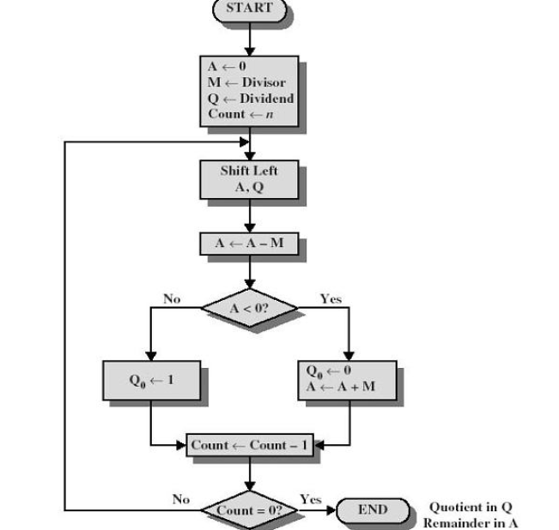

Slide 30
Restoring division (contd..)
Initially
0
0
0
0
0
1
0
0
0
0
0
0
1
1
Shift
0
0
0
0
1
0
0
0
Subtract
1
1
1
0
1
First cycle
Set
q
0
1
1
1
1
0
Restore
1
1
1
0
0
0
0
0
1
0
0
0
0
1
1
1
0
0
0
Shift
0
0
0
1
0
0
0
0
1
1
Subtract
1
1
1
0
1
1
Set
q
1
1
1
1
1
Second cycle
1
0
0
Restore
1
1
0
0
0
1
0
0
0
0
0
Shift
0
0
1
0
0
0
0
0
Subtract
1
1
1
0
1
Set
q
0
0
0
0
0
1
Third cycle
Shift
0
0
0
1
0
0
0
0
1
Subtract
1
1
1
0
1
0
0
1
Set
q
0
1
1
1
1
1
Fourth cycle
Restore
1
1
0
0
0
1
0
0
0
1
0
Remainder
Quotient

Slide 31
Non-restoring division
Restoring division can be improved using non-restoring algorithm
The effect of restoring algorithm actually is:
If A is positive/sign of A is 0, we shift it left and subtract M, that is compute 2A-M
If A is negative/sign of A is1, we restore it (A+M), shift it left, and subtract M, that
is, 2(A+M) – M = 2A+M.
Set q₀ to 1 or 0 appropriately.
Non-restoring algorithm is:
Set A to 0.
Repeat n times:
If the sign of A is positive:
Shift A and Q left and subtract M. Set q0 to 1.
Else if the sign of A is negative:
Shift A and Q left and add M. Set q0 to 0.
If the sign of A is 1, add A to M.

Slide 32
Non-restoring division (contd..)
Initially
0
0
0
0
0
1
0
0
0
0
0
0
1
1
Shift
0
0
0
0
1
0
0
0
First cycle
Subtract
1
1
1
0
1
Set
q
0
1
1
1
1
0
0
0
0
0
Shift
1
1
1
0
0
0
0
0
Add
0
0
0
1
1
Second cycle
1
0
Set
q
0
1
1
1
1
1
0
0
0
0
1
1
1
0
0
0
1
1
Shift
1
1
1
1
0
0
0
0
1
Add
0
0
0
1
1
Third cycle
1
0
Set
q
0
0
0
0
0
1
0
0
0
1
Shift
0
0
0
1
0
0
0
1
Subtract
1
1
1
0
1
Fourth cycle
Set
q
0
1
1
1
1
1
0
0
1
0
Quotient
1
1
1
1
1
Add
0
0
0
1
1
Restore
remainder
0
0
0
1
0
Remainder

Slide 33
Non Restoring Algorithm
In non restoring Algorithm, M is not added if the difference is negative, instead negative difference is shifted left and then M is added.
In Non restoring Method, M is subtracted if the previous value of Qo was a 1, but M is added if the previous value of Qo=0 and no restoring of the partial remainder is required.
The first time the dividend is shifted ,M must be subtracted.
Step2 of the algorithm is done to get the proper reminder in A.
Exactly one add/subtract takes place per cycle in Non restoring Division

